Slide 1
Loops
Recitation 5

Slide 2
for
for (initialize, condition, update). Execute the steps as long as the condition is true.
for (int i = 0; i < 10; i ++) { statement1; }

Slide 3
while
While condition is true, keep doing repeatedly until condition is false.
while (condition) { statement1; }

Slide 4
do-while
Executes the statements and checks if it needs to repeat at the end.
do { statement1; } while (condition)

Slide 5
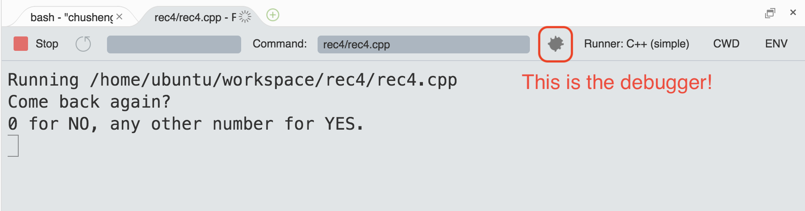
Debugger
A powerful tool to identify the bugs
Run step-by-step
Watch the value of variables

Slide 6
Strings
A string literal can be defined using double quotes.
Strings represent a sequence of characters.
Access the character at a particular index in a string using square brackets.
The first character in a string is located at index 0
string s = "Hello, world!"; char c = 'A';
H | e | l | l | o | , |  | w | o | r | l | d | !
0 | 1 | 2 | 3 | 4 | 5 | 6 | 7 | 8 | 9 | 10 | 11 | 12

Slide 7
Finally, I can speak through code!!
string question = "How I feel when there is no coffee?"; string answer = 'DEPRESSO :(';

Slide 8
Useful string functions
length()
substr()
find()
split()
…
Google “c++ string”

Slide 9
length()
Returns length of a string
string answer = 'DEPRESSO :(';
// returns length of answer, which is 11.
answer.length()

Slide 10
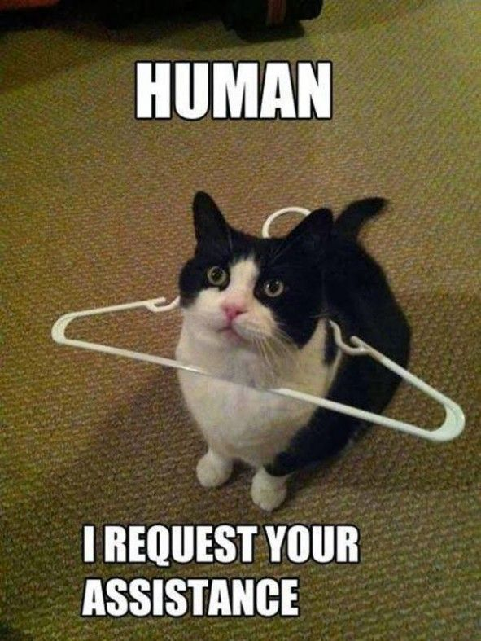
substr()
Generate substring
string me = 'HUMAN';
// returns length SUB string, which is ‘MA’.
me.substr(2, 2);

Slide 11
Reminder
Homework 4 is due Saturday 6:00 PM

